Slide 1
Session 1508: DISTAFF I –
Focus on Fibre
INTERNATIONAL MEDIEVAL CONGRESS:
University of Leeds, 4 July 2013

Slide 2
Woollens, Worsteds, and (Hybrid) Serges
English and Continental Terminologies for Wool-Based Textiles and Their Technological Significance (Medieval and Early Modern Eras)

Slide 3
Wool Fabrics & Fibres: problems of comparative terminologies
For textile historians of the pre-industrial era, nothing is more confusing and vexing than the very different English and continental nomenclatures (terminologies) for wool based textiles
But in essence, the currently-used English terms are faulty (or misleading), while the continental terms have greater accuracy and validity
To demonstrate this, we begin with early-modern England, and work back to the medieval eras on the continent and in England

Slide 4
Early-Modern England’s Wool-Based Textiles: Old and New Draperies
Well-known ‘duality’ of England’s wool-based textile industries in later 16th, 17th & 18th centuries:
(1) The Old Draperies: the heavy-weight, fulled, luxury quality woollen broadcloths (but also cheaper kerseys, straits, dozens, etc.)
(2) The New Draperies (so-called): composed of both:
a) worsteds: very light, relatively inexpensive
b) serges: a hybrid worsted-woollen fabric, with a worsted warp and woollen weft
- heavier & usually more costly than true worsteds
- but much cheaper & lighter than woollen broadcloths

Slide 5
‘Duality’ of medieval England’s wool-based textiles
Before the advent of the New Draperies (1570s), the accepted duality of England’s wool-based textiles was (supposedly) the following: in terms of fibres, for both warps & wefts --
(1) WOOLLENS: composed of very fine, weak, short-stapled, curly wool fibres, that were prepared by carding and spun on the spinning-wheel: but not true of medieval woollens
(2) WORSTEDS: composed of coarse, strong, longer-stapled, straight wool fibres that were prepared by combing and spun on the ‘rock’ (distaff with weighted drop-spindle of stone or bone)

Slide 6
Worsteds: according to Wikipedia & Answers.com
Worsted (pron.: /ˈwʊstɨd/) is a type of yarn, the fabric made from this yarn, and a yarn weight category. The name derives from Worstead, a village in the English county of Norfolk. This village, together with North Walsham and Aylsham, became a manufacturing centre for yarn and cloth in the 12th century when pasture enclosure and liming rendered the East Anglian soil too rich for the older agrarian sheep breeds
Worsted was made from the long-staple pasture wool from sheep breeds such as Teeswaters, Old Leicester Longwool and Romney Marsh. Pasture wool was not carded: instead it was washed, gilled and combed using heated long tooth metal combs, oiled and spun. When woven, worsteds were scoured but not fulled.[
Read more: http://www.answers.com/topic/worsted#ixzz2TaR7jGnv

Slide 7
The Continental medieval & early modern wool-textile terminologies
Continental duality is totally different (and much more accurate!):
A) French: draperie ointe vs. draperie sèche (latter also known as: draperie légère)
B) Dutch/Flemish: gesmoutte draperie [Iakenindustrie] vs. drooge draperie
[latter also: lichte draperie, lichte lakenindustrie]
- for both, the contrast is thus between the greased and the dry (ungreased) draperies
- the latter also known as the light draperies

Slide 8
Why greasing is the true and crucial distinction (1)
(1) short, curly, scaly fibred wools were necessarily greased (after scouring): using butter (or fish oils) in the north, and olive oil in the Mediterranean regions
a) After the preliminary wool-beating and wool-sorting, such short-fibred wools were first thoroughly scoured and cleansed in hot water with detergents ➔ to remove the natural lanolin in the wools
b) subsequently, they were greased - before preparation (combing or carding), spinning, and weaving: to protect these very fine delicate and scaly fibres from combs, cards & other textile tools

Slide 9
Why greasing is the true and crucial distinction (2)
(2) The coarser, straighter, stronger, longer-fibred wools were NOT so scoured
- they thus retained their natural lanolin
- which provided sufficient lubrication & protection for these stronger, longer, straighter fibres in the processes of combing, spinning, weaving, etc.
- hence these wools were left ‘dry’ (or only very lightly oiled before combing & spinning)

Slide 10
‘Greased’ Woollens and Fulling (1)
1) Importance of their short-fibred wools: very fine, curly, scaly fibres had excellent felting properties (in fulling processes)
2) When woven into cloth, such short-fibred wools lacked cohesion, strength, durability ➔
3) Fulling absolutely necessary to provide these properties: lest the woven cloth fall apart
4) Fulling Vat: long stone vat filled with hot water, fuller’s earth (kaolinite), soap, and urine: into which the woven cloth, taken from loom, was immersed, and then trod upon or pounded

Slide 11
‘Greased’ Woollens and Fulling (2)
5) Foot-fulling vs. mechanical fulling:
a) Foot-fulling: traditional mode for centuries
- two journeymen fullers, supervised by a master, trod upon the broadcloth (about 30 m. by 2.54 m.), for 3 to 5 days (according to quality)
b) Mechanical fulling: water-mills, with crank & flyshaft, to convert rotary into reciprocal power: operating two oaken-wood hammers: to pound the cloth, in alternation, for about 12 hours

Slide 12
‘Greased’ Woollens and Fulling (3)
6) Fulling Mills: in European cloth production
- first used in 10th-century Italy; in northern Europe from 12th century
- widespread in England from later 13th cent
a] pros: cost savings of about 75% (reducing value-added cost from 20% to under 5%)
b] cons: belief that mill-pounding damaged delicate wool fibres ➔ resisted in luxury-quality cloth industries, esp. in Low Countries

Slide 13
‘Greased’ Woollens and Fulling (4)
7) Three-Fold functions of Fulling Woollens:
a) scouring & degreasing: to remove the butter or oil: urine & fuller’s earth combined with grease ➔ soap for further cleansing
b) felting: to force the curly, scaly, short fibres to interlace, interlock into cohesive, ultra-strong, durable cloth (virtually indestructible)
c) shrinkage: by up to 55% by area (more width than length) ➔ chief reason for heavy weight

Slide 14
‘Greased’ Woollens and Fulling (5)
8) Fulling and Woollen Cloth Finishing:
a) fulled cloths stretched on to a tentering frame (with tenter hooks): to remove wrinkles & restore some of the loss from shrinkage
b) subjected to ‘raising’ or teaseling (both wet & dry), to raise the nap (loose fibres)
c) napped cloth then shorn with razor-sharp steel shears: repeated napping & shearing [aka: raising and cropping]
d) fulled & shorn woollens: weave patterns obliterated ➔ texture as fine as silk

Slide 16
Worsteds vs Woollens (1)
1) Worsteds and their wools
a) warp and weft yarns: both spun from dry, strong, straight, long-stapled combed wools
b) fabric basically completed when woven: its long-stapled wools provided the woven fabric with sufficient cohesion, strength, and durability on the loom, thus without fulling – but not as strong & durable as a fulled woollen cloth.
c) finishing: by dyeing, pressing, calendaring (running cloth through rollers ➔smoothing)

Slide 17
Worsteds vs Woollens (2)
2) Worsteds: differences from true woollens
a) no fulling, napping, shearing required
b) worsteds thus distinguished by their highly visible weaves: often lozenge or diamond twill (obliterated in fulling/finishing woollens)
c) worsteds much lighter than woollens (including kerseys): often only 25% as heavy
d) worsteds were generally much cheaper than woollen broadcloths: though not that much cheaper than coarser woollens, such as ‘straits’

Slide 18
Worsteds vs Woollens (3)
3) Serges: hybrid worsted-woollens
a) worsted, dry, combed WARP and a greased woollen, carded WEFT
b) cursory fulling only: chiefly to remove the grease:
- Hondschoote sayetterie: one day of fulling only
c) between worsteds and woollen broadcloths in weight and value: but most were far closer to worsteds in both respects
d) continental draperies: these fabrics were classed with worsteds as draperies sèches, draperies légères;
- generally known as serges (from the 12th century)

Slide 19
Worsteds vs Woollens (4)
4) England’s New Draperies: from 1570s
a) serges: most important component of New Draperies in East Anglia (Norfolk, Suffolk)
b) Other names: says, bays, stuffs, bombasines, perpetuanas [say: from saga = Roman military cloak]
c) also other mixed fabrics: using goat’s hair, linen, cotton, silk, etc.; along with true all-combed worsteds
d) New fabrics imported by Flemish Protestant refugees, with Revolt of Netherlands (1568-1609)
e) Hondschoote sayetterie: chief model (with dry worsted warps and greased woollen wefts)

Slide 20
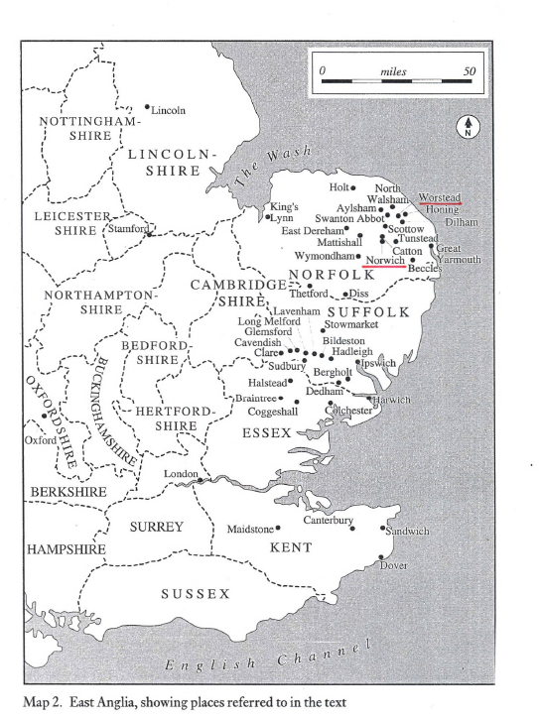

Slide 21
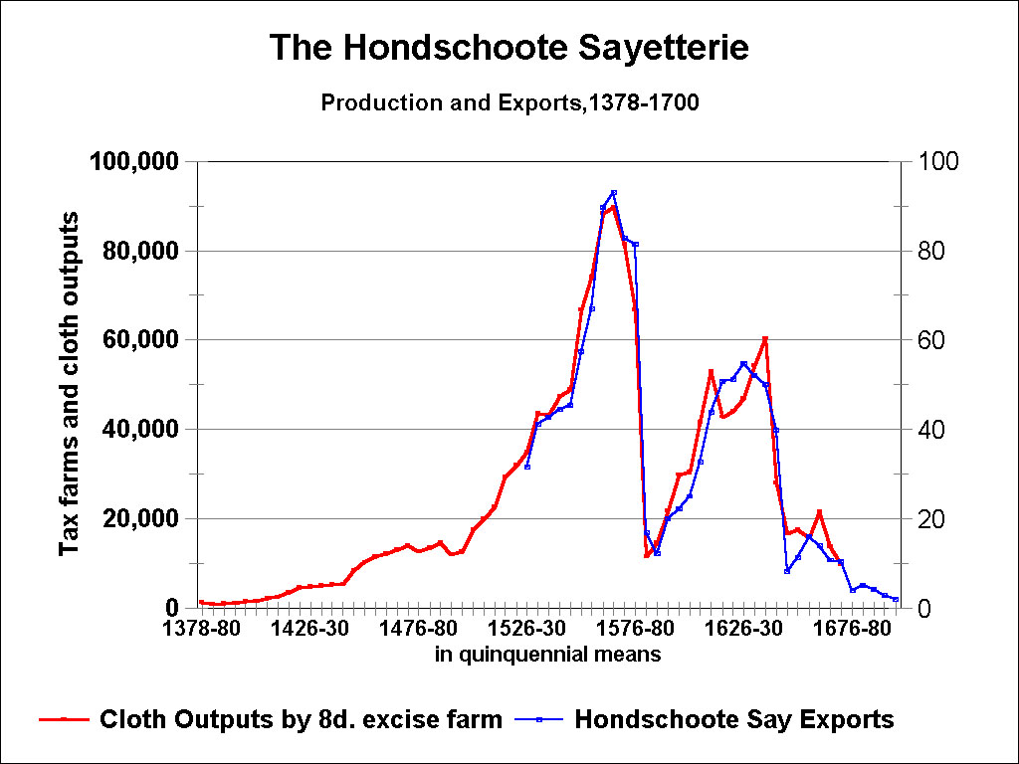

Slide 22
Coleman on Origin of the ‘New Draperies’: terminological confusion 1
1) D.C. Coleman: origins of England’s New Draperies (its hybrid fabrics) to be found ultimately in Italy, though via Flanders, from 1570s: see Coleman, ‘The New Draperies’, Economic History Review, 22:3 (Dec 1969)
2) Reason: that Italians (Florence) had long produced similar mixed fabrics: supposedly with a worsted warp and a woollen weft
- but in fact not so!

Slide 23
Coleman on Origin of the ‘New Draperies’: terminological confusion 2
3) Coleman’s Errors - shared by many historians:
a) Not realizing that these Florentine cloths were genuine heavy weight costly woollens of the true draperie ointe: made entirely from greased, fine, very short-stapled wools: indeed from very best English wools: Welsh Marches & Cotswolds
b) Not knowing that almost all later-medieval woollens, north and south, were made from COMBED warps and CARDED wefts - or made entirely from combed but short-stapled wools

Slide 24
Solution to the Coleman Conundrum: the medieval evolution of spinning (1)
1) All European woollens had once been made uniquely from short-fibred combed wools, which were ‘rock’-spun (distaff & drop-spindle), before the later 13th or 14th century
- smaller, finer-toothed combs than for worsteds
2) Later 13th – 14th century: introduction of both CARDING & the SPINNING WHEEL, from Muslim Spain (cotton industries)
3) Fierce opposition to both throughout western Europe for luxury woollens: on grounds of both quality and cloth-durability

Slide 25
Medieval Evolution of Spinning (2)
4) Chief problem cited: spinning-wheel’s defects
a) that wheel-spun carded wools – from curly short-fibred wools -- produced yarns that were too weak , uneven, and knotty for warp yarns
b) reason: discontinuous nature of wheel-spinning: in drafting, twisting, & winding- on ➔ yarns of uneven thickness & strength [Bruges: Livre de Mestiers, 1349]
5) Countervailing advantages: carding and spinning wheel provided enormous labour-cost savings in preparing short-fibred wools to become yarns for loom: a 3-fold or more productivity gains

Slide 26
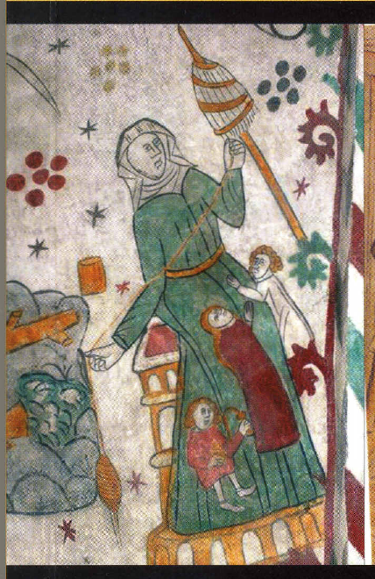
Medieval Spinning: Drop-Spindle

Slide 27
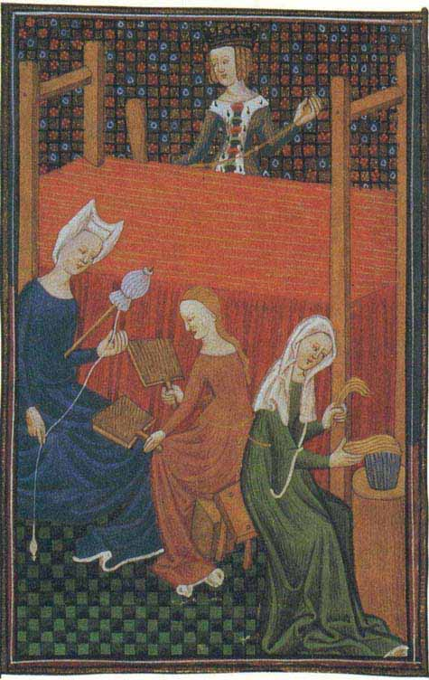
Medieval spinning, carding, combing

Slide 28
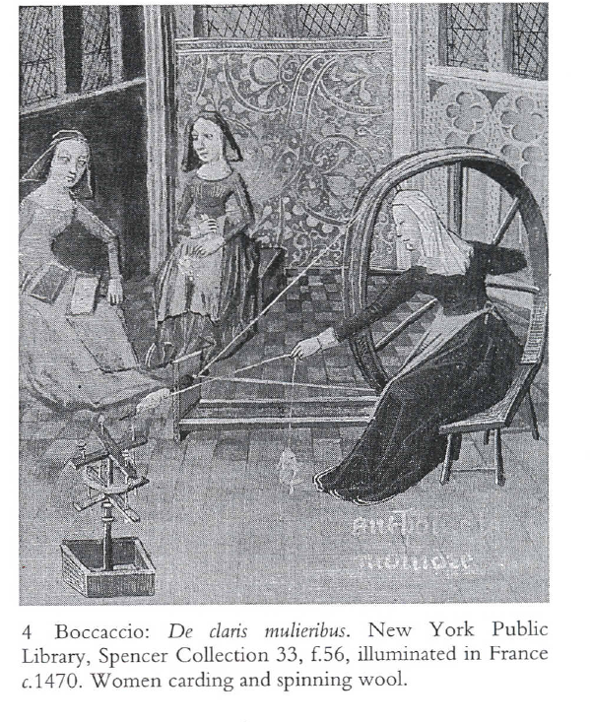

Slide 29
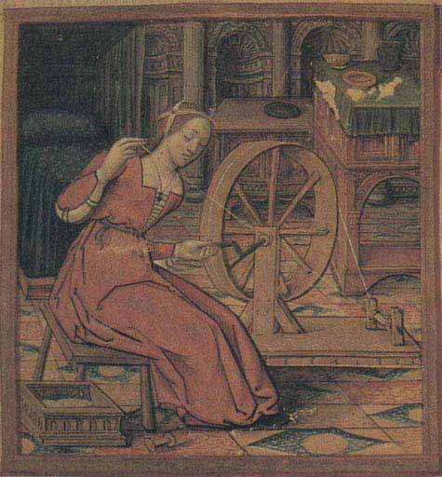
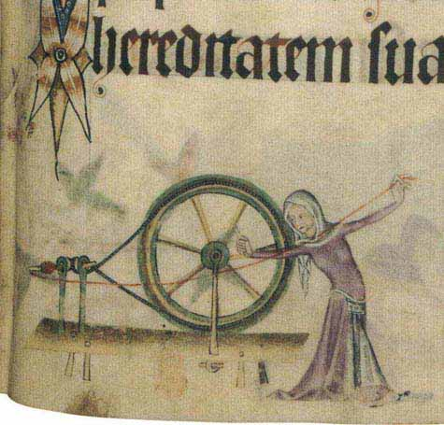
Medieval wheel-spinning at home

Slide 30
Medieval Evolution of Spinning (3)
6) Compromise solution - that became widespread by mid 14th century: to permit carded wheel-spun yarns for the WEFT, only, while requiring traditional combing + ‘rock’-spinning for the WARPS
- that produced both the strongest & finest yarns.
7) Reason: the weaving process on horizontal loom
a) warps were subjected to enormous stress, while stretched on the horizontal looms: from warp beams to cloth beams, through lever-operated heddles ➔ so that wheel-spun yarns tended to break
b) wefts underwent no such stress: inserted in shuttles between warps alternatively separated by heddles.

Slide 31
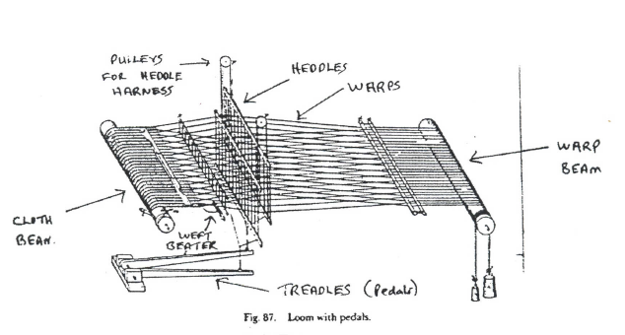

Slide 32
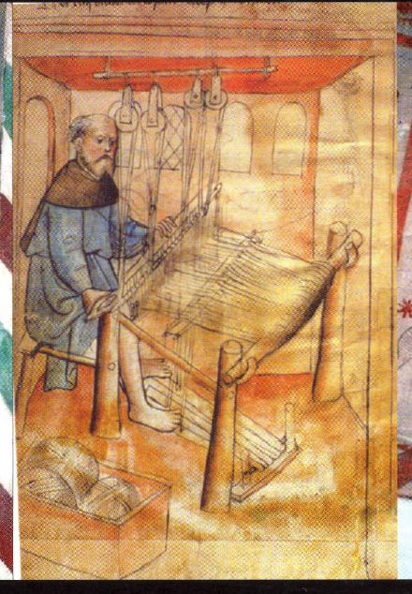
Medieval Horizontal Loom: with foot-powered treadles

Slide 33
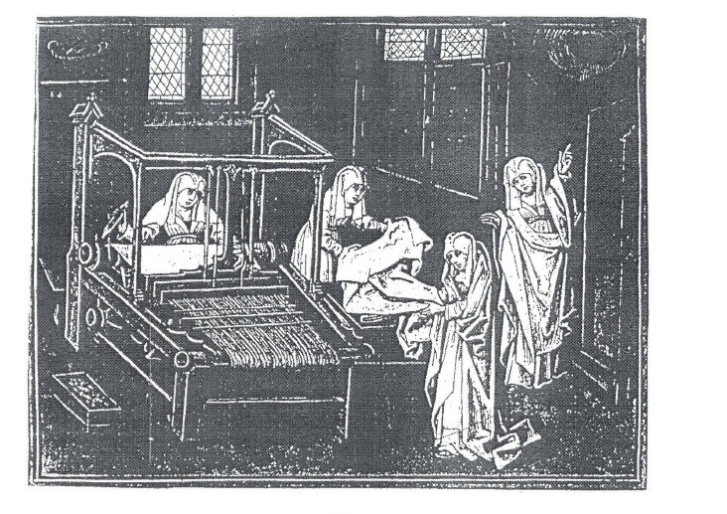

Slide 34
Medieval Evolution of Spinning (4)
8) Adoption of the Flyer (Saxony) Wheel: as a possible solution to permit ‘all-carded’ woollens – with both warps and wefts wheel-spun (subject of debate):
a) Flyer Wheel: from early to mid 15th century
b) radical innovation: U-shaped flyer fixed on the spindle axle containing a separately rotating bobbin for winding-on the spun yarn –with continuous belt-drive looped over both the spindle-pulley & bobbin-pulley , to which a ‘tensioner’ was later added.
c) importance: permitted a fully continuous and smoothly operating motion for drafting, twisting, & winding-on ➔ even, fine, strong yarns for warps

Slide 35
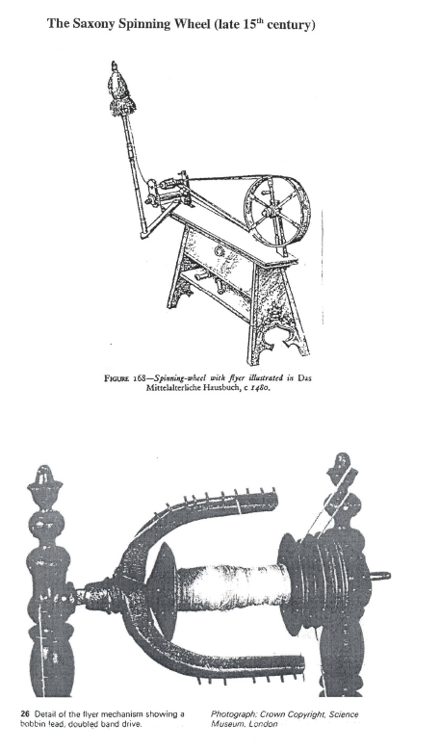

Slide 36
Medieval Evolution of Spinning (5)
9) Flyer Wheel in Woollens Industry: some evidence?
a) from 1435: in Mechelen: recorded purchases of gecaerde lakenen: as new, high-priced woollens given to mayor & town aldermen [probably from all-carded yarns]
b) 1467: Leuven drapery ordinance: revoked long-standing ban on using ‘wheels’ for spinning woollen warps in luxury woollen cloths
c) 1467: Brussels drapery ordinance: same provisions, permitting drapers to use either carded or combed wools in warps for finest luxury cloths (even scarlets) woven from the best English wools (Fine March, Cotswolds, etc.)
d) 1464: England: statute 4 Ed. c. 1: officially recognized and permitted carding in the now regulated woollen crafts

Slide 37
Medieval Evolution of Spinning (6)
10) Some Further Evidence: iconographic
a) 1475-80: Swiss Das Mittelalterliche Hausbuch (Waldburg-Wolfegg): accurate drawings of Flyer Wheel: with U-shaped flyer (see previous slide)
b) 1490: Leonardo da Vinci’s Codice Atlantico: similar drawings of Flyer Wheel
c) 1513: Lucas Van Leyden: engraving of spinster with Flyer Wheel
d) early 16th cent: Jan Van Galle (Flemish): painting of Flyer Wheel with implements for woollens: cards, teasel-frame, cropper-shears
e) Picard flyer wheels: 16th century variants (paintings)

Slide 38
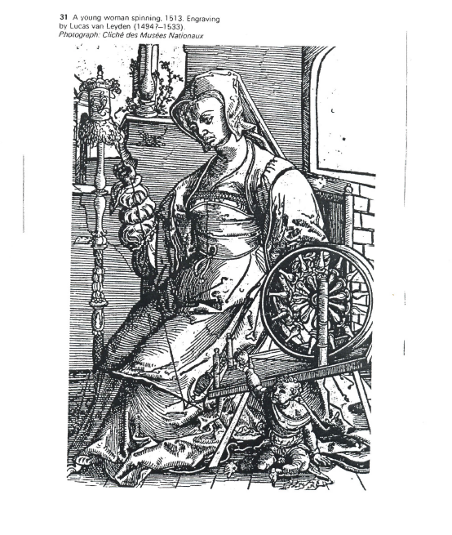

Slide 39
Opposing Views 1
11) Some Opposing Views on All-Carded Woollens and Flyer Wheel:
a) Use of Flyer Wheel in spinning carded warps for woollens is specifically denied in:
Hugo Lemon, ‘The Development of Hand Spinning Wheels,’ Textile History, 1 (1968-70).
Kenneth Ponting, The Woollen Industry of South-West England: An Industrial, Economic, and Technical Survey (Bath and New York, 1971).
both contend it was used only for linen and worsted warp yarns

Slide 40
Opposing Views 2
b) Patrick Chorley, `Evolution of the Woollen`, in N.B. Harte, The New Draperies in the Low Countries and England (Oxford, 1997)
- never refers to the Saxony or any Flyer Wheels
- dates emergence of all-carded woollens later than I do: to the late 16th or 17th century (though possibly earlier in England – but no evidence)
- no explanation: except other improvements in carding and design of the Great Wheel (traditional but large spinning wheel).
c) BUT see Patricia Baines, Spinning Wheels, Spinners, and Spinning (London, 1977): for its use in woollens

Slide 41
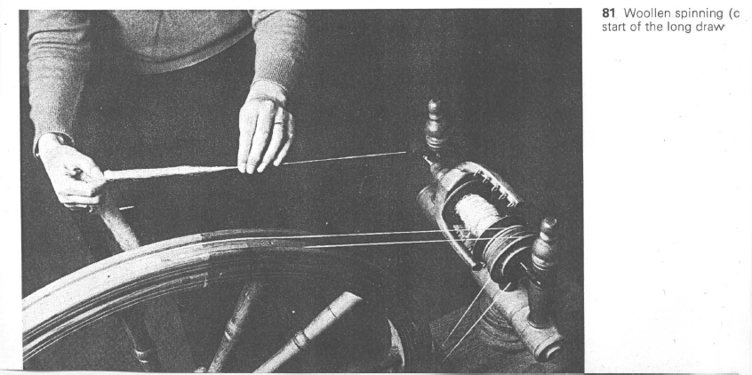
Baines: demonstration of spinning woollen yarn with the Flyer Wheel

Slide 42
Old & New Draperies Revisited: 1
1) Old Draperies: Woollens
a) Later Medieval woollens: composed entirely of fine, short-stapled, curly wools, which were:
i) for warps: combed & rock-spun
ii) for wefts: came to be carded & wheel spun, in most of late-medieval western Europe (though some remained entirely combed)

Slide 43
Old & New Draperies Revisited: 2
b) Early-Modern Old Draperies: using same short-stapled fine wools: English & now Spanish merino
for which both warps and wefts were composed of carded, wheel-spun wools (Flyer Wheel for warps?)
- all-carded woollens: heavier than semi-carded woollens, by having far more carded wool in the warp yarns, with 1:1 ratio - cf. the table below for Ghent and Armentières woollens
– BUT some 16th century cloth industries retained combed wools for the warps: e.g., in Florence, Leiden;
- 17th century Leiden: now making all-carded woollens

Slide 44
Old & New Draperies Revisited: 3
2) New Draperies: Serges as Hybrid fabrics
a) warps: DRY long-stapled, strong, coarse combed wools, either rock-spun or spun on Flyer (Saxony) Wheel
b) wefts: GREASED short-stapled, curly, fine wools that were carded and wheel-spun (with traditional Great Wheels)
c) Origins and model: Hondschoote sayetterie

Slide 45
Tables on Woollens, Worsteds, and Hybrid Serges
Following tables demonstrate that:
worsteds were generally much lighter and much cheaper than woollen broadcloths:
draperies sèches vs. draperies ointes
serges and other hybrid worsted-woollen fabrics were in between, but far closer to worsteds than to true woollen broadcloths:
- part of the draperie légère/lichte draperie

Slide 49
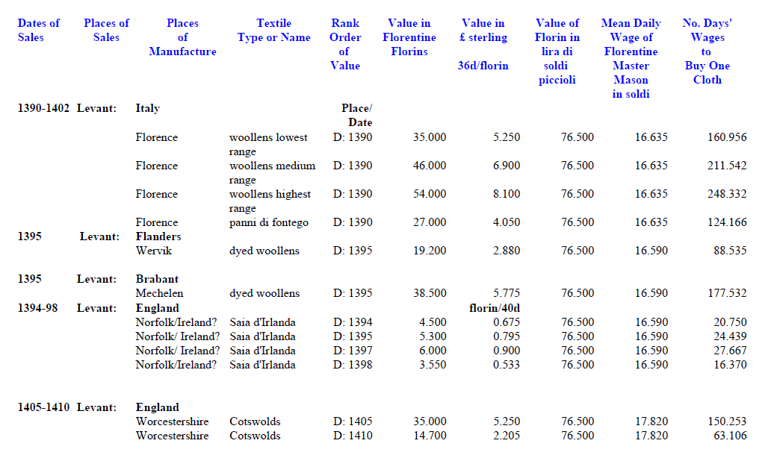

Slide 50
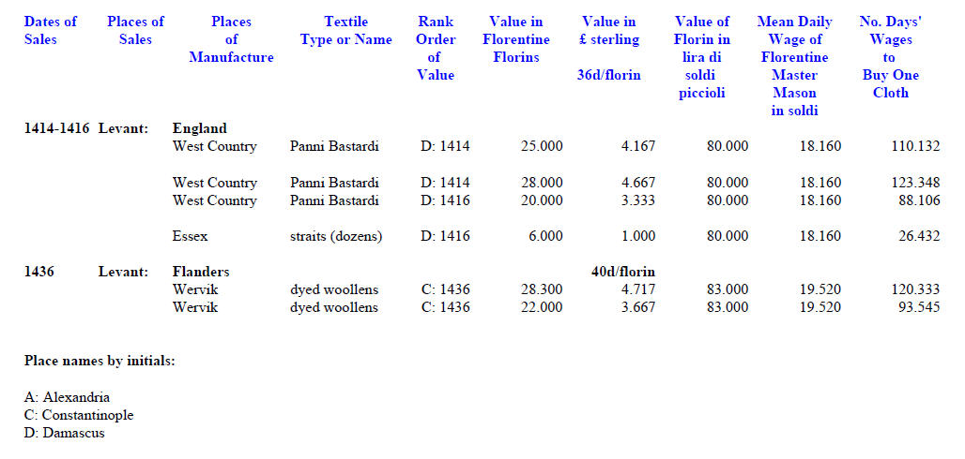

Slide 51
No. of Master Mason’s Daily Wages (Florence) to buy 1 cloth, 1390 - 1436
Date of Sale | Place of Manufacture | Type of Cloth | Price of Cloth in Gold Florins | No. Days’ Wages to Buy One Cloth
1394-98 | Norfolk/Ireland? | Saia d’Irlanda | 3.550 | 16.370
1394-98 | Norfolk/Ireland? | Saia d’Irlanda | 4.500 | 20.750
1394-98 | Norfolk/Ireland? | Saia d’Irlanda | 6.000 | 27.667
1390-1410 | England: Essex | straits (dozens) | 6.120 | 27.125
1390-1402 | Florence | San Martino H | 54.000 | 248.332
1390-1402 | Florence | San Martino L | 35.000 | 160.956
1390-1410 | Flanders: Bruges | dyed woollen | 44.010 | 195.062
1395 | Flanders: Wervik | dyed woollen | 19.200 | 88.535
1395 | Brabant: Mechelen | dyed woollen | 38.500 | 177.532
1405-10 | England: Worcs. | Cotswolds | 35.000 | 150.253
1436 | Flanders: Wervik | dyed woollen | 28.300 | 120.333

Slide 52
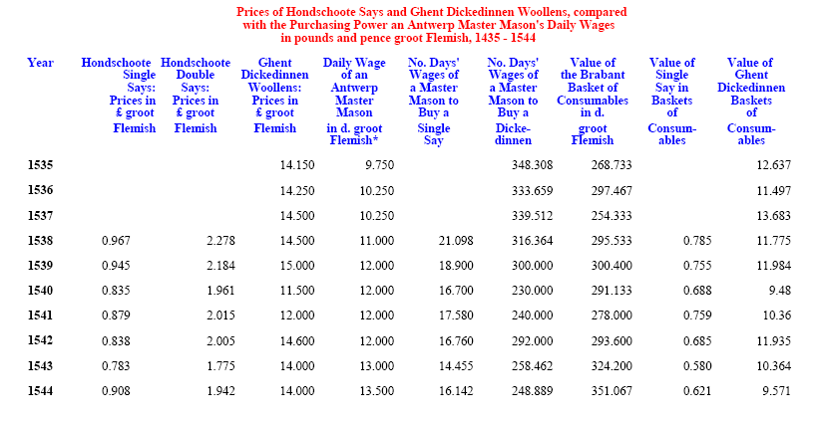

Slide 53
No. of Daily Wages (Antwerp master mason) to buy 12 sq. metres of cloth: 1538-1544
Year | Hondschoote single say | Hondschoote double say | Ghent Dickedinnen
1538 | 13.788 | 21.401 | 108.379
1539 | 12.343 | 18.808 | 103.115
1540 | 10.906 | 16.888 | 79.055
1541 | 11.481 | 17.353 | 82.492
1542 | 10.945 | 17.267 | 100.365
1543 | 9.440 | 14.110 | 88.837
1544 | 10.542 | 14.866 | 85.547

Slide 54
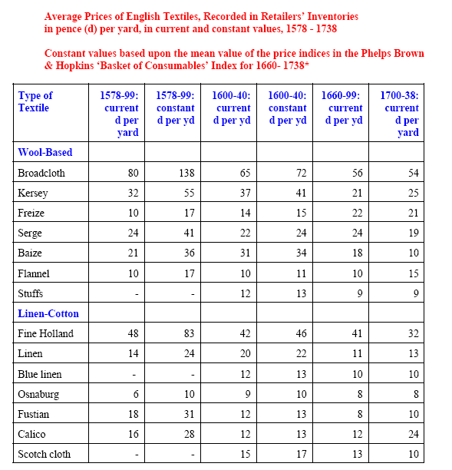

Slide 55
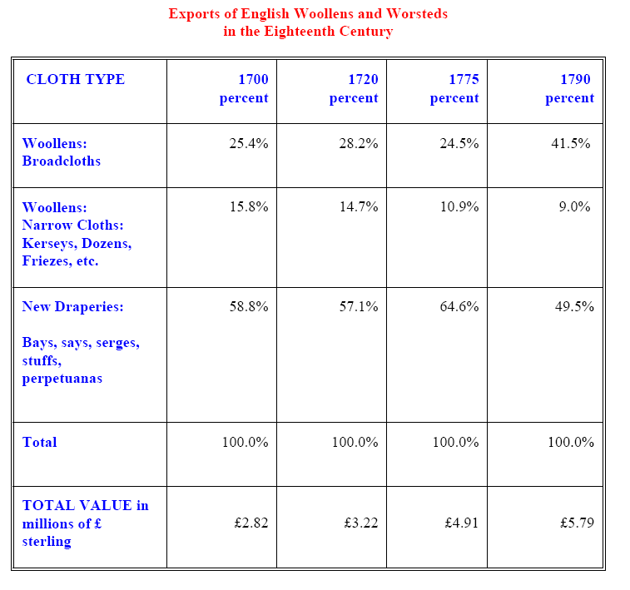

Slide 56
CONCLUSIONS
1) The continental terminologies to distinguish wool-based fabrics by fibre: are far more useful
A) draperies ointes (ghesmoutte): greased
B) draperies sèches (drooge): dry; and also ipso facto => draperies légères (lichte draperie): light draperies
C) serges: most common term for hybrid worsted-woollens fabrics (as in England): classed with light draperies (above)
2) English fibre terms are deceptive:
A) Worsteds: Norfolk place name only
B) Woollens: ignores historical transformations from all-combed, all-distaff (rock) spun wools to all carded, all wheel spun wools: but always short-fibred wools

Slide 57
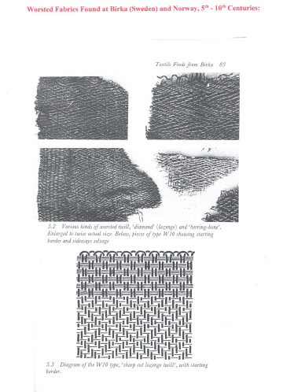

Slide 58
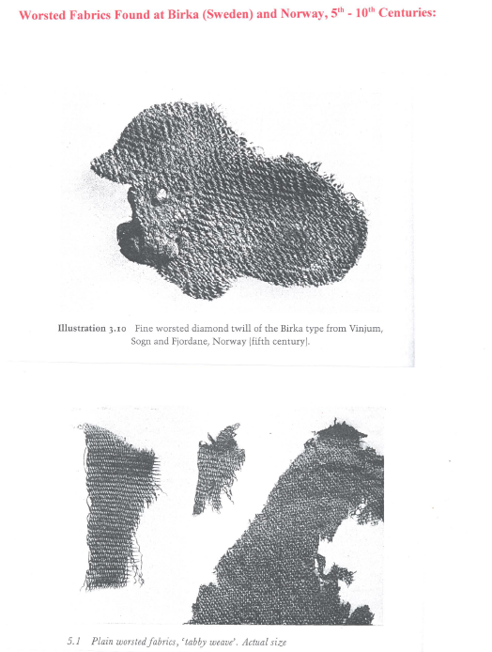

Slide 59
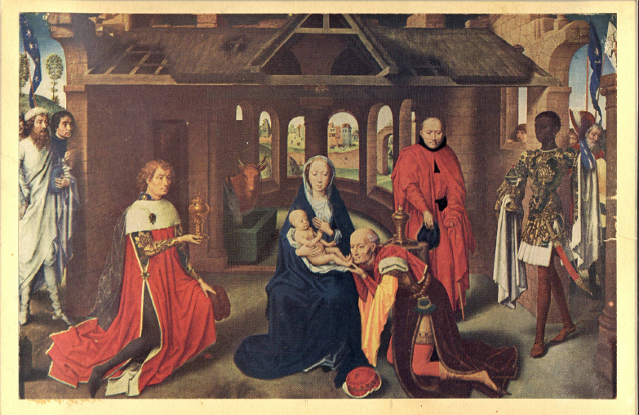
Memling: Adoration of the Magi

Slide 60
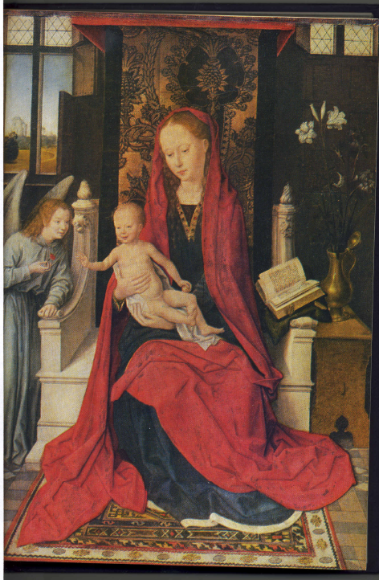
Memling, Madonna & Child (1490)

Slide 61
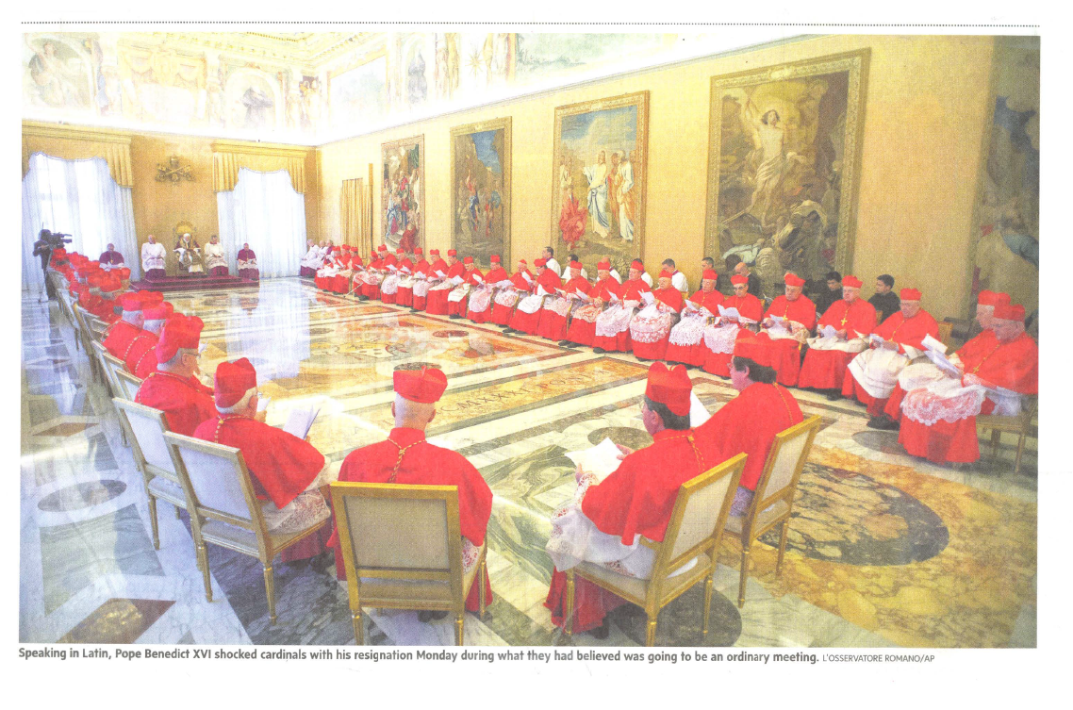

Slide 62
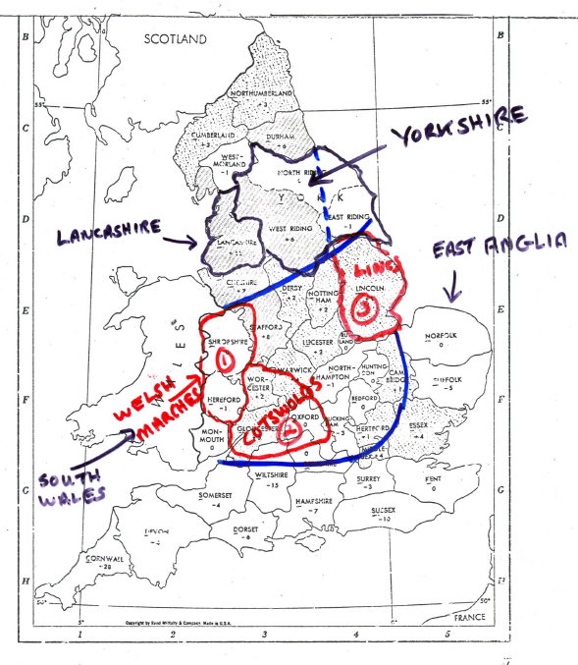

Slide 63
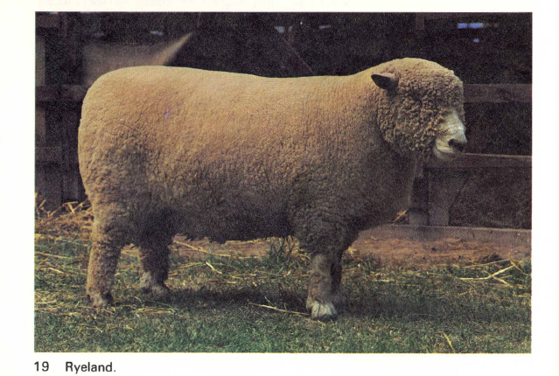

Slide 64
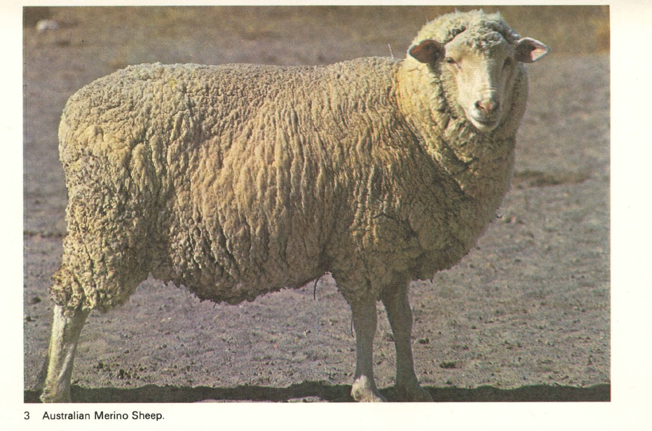

Slide 65
A Thousand-Year (& more) Survey of Wool-Based Textiles
1) 5th – 11th Centuries: Primacy of Worsteds, woven on vertical warp-weighted looms
2) 12th – 13th centuries: Emergence of Woollens and Serges: with introduction of horizontal loom, carding, and spinning wheels (semi-carded woollens by 14th century)
3) 14th-15th centuries: Primacy of Woollen Broadcloths: as warfare + population decline ➔ raised transaction costs in international commerce ➔ curtailing trade in cheaper fabrics ➔ reorienting trade to luxury woollens (& silks)
4) 16th – 17th centuries: Primacy of New Draperies: relative peace + population growth + transport innovations ➔ lowered transaction costs ➔ promoted revival & growth of international trade in cheaper (& lighter) textiles

Slide 66
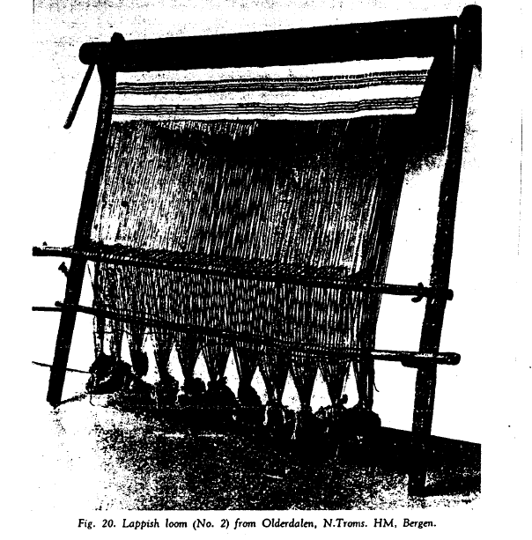

Slide 67
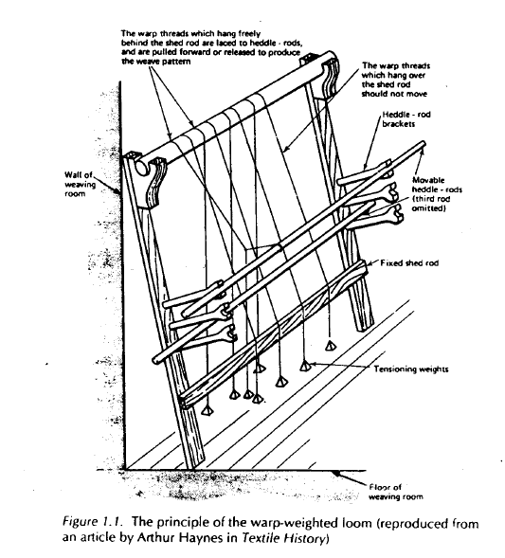

Slide 69
Livre des Mestiers: on Spinning
Bruges: 1349 manual on crafts in French & Flemish
- Cecile le Fileresse -- Et elle prise moult rofile qui ful filé à le kenouille; mais le fil que on fila au rouwet a trop de nues. Et elle dist qu’elle waingne pluis à filer estain a le kenouille que à filer trame au rouwet.
- Cecile de spinnigghe … soe priis de seer u ghaern dit was ghesponnen metten rocken; maer t’ gaeren dat men span metten wiele heeft te vele knoepen. Ende so zeight dat soe windt meer te spinnene werp metten rocke dan te spinnene wevel metten wiele.
That wheel-spun wefts have too many knots; and that she earns more by spinning [combed] warp on the distaff than by spinning [carded] weft by the wheel.

