Slide 1
Medieval Academy of America: Annual Meeting, April 2013
Session 5 (Salon E): 4 April 2013
Economic and Cultural Interactions in Northern Europe
John Munro, University of Toronto

Slide 2
How Golden was the Burgundian ‘Golden Age’ in the 15th century?
How financing warfare reduced the living standards of urban craftsmen in the southern Low Countries

Slide 3
The Burgundian Golden Age 1
In the Burgundian Low Countries, the 15th century is commonly viewed as the late-medieval ‘Golden Age’
Such a term can apply, however, only to the second half of Duke Philip the Good’s reign (1419-67)
–from peace treaty of Arras with France, in Sept. 1435, to Philip’s death in 1467
Rest of century suffered from destructive warfare
a) previous period: especially 1416-35
b) the succeeding and more war-torn reigns of Duke Charles (1467-77), Duchess Marie (1477-82) and Habsburg Archduke Maximilan (especially civil wars of 1482-1493)

Slide 4
The Burgundian Golden Age 2
At least the second half of Duke Philip’s reign (1435-67) should qualify for the term ‘Golden Age’: for two reasons:
(1) social and cultural: the flourishing of literature and the arts --- music, painting, architecture – especially at the greatly expanded Burgundian court in Brussels
(2) economic:
- rising real wages: for many urban craftsmen
- other signs of urban prosperity in the most highly urbanized society of northern Europe

Slide 5
The Burgundian Golden Age 3
Major Thesis of this Paper:
(1) Despite widespread European evidence for rising real wages and incomes in the 15th century, even Philip the Good’s reign was no ‘Golden Age’ for the Burgundian Low Countries
(2) Rising real wages were the product NOT of economic growth or prosperity, but rather of Deflation combined with Nominal Wage Stickiness: both of which reflect depression rather than growth & prosperity

Slide 6
The Burgundian Golden Age 4
(3) In Low Countries, in contrast to England, the rise in real wages was often counteracted by war-related monetary & fiscal policies
a) by coinage debasements, to produce seigniorage revenues ➔ severe inflations
b) excise taxes on consumption (hitting the poor most adversely) in order to provide payments on rising public debts almost entirely for financing warfare/defence

Slide 7
The Burgundian Golden Age 4
(4) Other negative war-related factors:
- a) continuing population decline, especially rural
- b) poverty: evidence for increasing incidence of poverty (tax relief for the poor)
- c) severe, irredeemable decline of region’s industrial mainstay: woollen textiles
- but the last is not topic of this paper

Slide 8
What do ‘Real Wages’ Mean? (1)
1) The ‘real wage’ is simply the purchasing power – in goods and services – of the nominal money wage paid to the craftsmen, usually in current silver coin: wage defined in money-of-account
2) Usually measured in terms of the daily wage (paid by the day, not the hour): and so we cannot measure annual money incomes without knowing number of days of paid employment
here: an estimate of 210 days employment
3) Real Wages are NOT real incomes – but best proxy

Slide 9
What do Real Wages Mean? (2)
4) Two ways of measuring Real Wages:
a) by Index numbers: here the ‘base’ for the indexes: the mean of 1451-75 = 100:
- The formula is: NWI/CPI = RWI
- Nominal Money Wage Index divided by the Consumer Price Index = Real Wage Index
b) by the number of commodity baskets that a master mason could purchase with his annual money wage income (for 210 days).

Slide 11
What do Real Wages Mean? (3)
5) The Economists’ Definition of Real Wages:
a) RW = MRP_{L}: the real wage is determined by the marginal revenue product of labour
b) the market value of the last (marginal) unit of product produced by the last unit of labour
c) many economists too simplistically believe that increases in labour productivity provide the sole explanation for rising real wages

Slide 12
The problem of Wage Stickiness
1) A predominant feature of late-medieval wages is (downward) nominal WAGE-STICKINESS: from 1370s
2) More precisely, this phenomena is normally found only during times of deflation – with falling or generally stable prices: that is, nominal wages usually remained rigid and did not fall along with other prices ➔ RW rise
3) During times of inflation, nominal money wages may rise, but usually less so than prices ➔ RW fall
4) Therefore: real wages were largely determined by movements of the price level:

Slide 13
Money & Prices
- Behaviour of prices : fundamental to study of real wages (and incomes) in late-medieval society
(1) changes in relative prices (short & long term): largely a function of real factors: such as demography, commercial institutions, technology, etc.
(2) changes in nominal prices with both short- and long-term behaviour of the price level (CPI): largely, but not entirely, a function of monetary factors, combining changes in the STOCKS & FLOWS OF MONEY, relative to real factors: M.V = P.y (M = kPy)
A) monetary expansion ➔ inflation (usually)
B) monetary contraction ➔ deflation (usually)

Slide 14
Coinage Debasements (1)
1) Coinage Debasements: the only monetary factor to be discussed here: with even short-run importance in the price level
2) Definition of debasement: a reduction in the quantity of fine precious metal represented in the unit of the money-of-account: e.g., the quantity of pure silver in the penny (d), shilling (s), pound (£):
- £1 = 20s. = 240d.

Slide 15
Coinage Debasements (2)
3) How debasements were achieved
a) by reducing the fineness: more copper ➔ less silver (or gold) in the coin; and/or by
b) by reducing the weight of the coin itself
c) by increasing the money-of-account value of the coin: virtually always only for gold and high-value silver coins (never for the penny)
- the results for the first two was to INCREASE the number of coins struck from a lb or marc of fine metal
and for all three, the result was to REDUCE the quantity of such metal in the money-of-account unit

Slide 16
Coinage Debasements (3)
4) Motives for debasements: two-fold
a) aggressive fiscal policy: to increase prince’s seigniorage revenues (tax on minting) by luring/forcing more bullion to his mints – one of few elastic revenue sources at his command
b) defensive monetary policies:
i) to protect a realm’s money supplies and mints from its neighbour’s predatory mint policies
ii) to remedy deficiencies in current circulating coinages, with deterioration from counterfeits, clipping, normal wear & tear etc. [complicated]

Slide 17
Coinage Debasements (4)
5) Coinage Debasements: Effects on Prices
a) almost always INFLATIONARY: because debasements increased both the effective money supply (number of circulating coins) and often also the income velocity of money
b) But inflationary effects were generally less powerful than would normally be expected:
i) offset in part by prevailing deflationary conditions
ii) offset by stimulus that inflation ➔  production
ii) money supply not increased proportionally: not all current coins were reminted; and many coins would be exported (especially coins of the other metal)

Slide 18
Coinage Debasements (5)
5) Coinage Debasements: Effects on Prices
c) N.B.: relationship between debasement and inflation is NOT directly proportional, but inversely related, as reciprocals:
(1/1 - x) - 1, where x = the percentage reduction in the silver content of the money of account.
Thus, with a 20% reduction in the silver content of the coin: (1/1 - 0.20) - 1 = 0.25,
➔ a 25% increase in the money-of-account value of a marc or pound of fine silver (but NOT necessarily of prices in general).

Slide 19
The Statistical Evidence on Real Wages
The following slides are presentations of the evidence for real wages of urban building craftsmen, in the 15th century, for the following:
In SW England: at Oxford & Cambridge colleges
In Flanders: for the towns of Bruges and Aalst
In Brabant: for the Antwerp-Lier region
For more effective comparisons, real wages for previous & later periods are shown – when and where they are available.

Slide 20
The Special Case of England
The 19th-century English economist, James E. Thorold Rogers (1823-90), stated that:
- the fifteenth century was the Golden Age of the English artisan: in terms of the purchasing power of his money wages.
Or the post-Plague era: from 1370s: Rogers and most historians believe that depopulation was the major cause of rising real wages in the later Middle Ages: by increasing labour productivity
the following graphs demonstrate why the 15th century is seen as a ‘Golden Age’ for artisans:

Slide 21
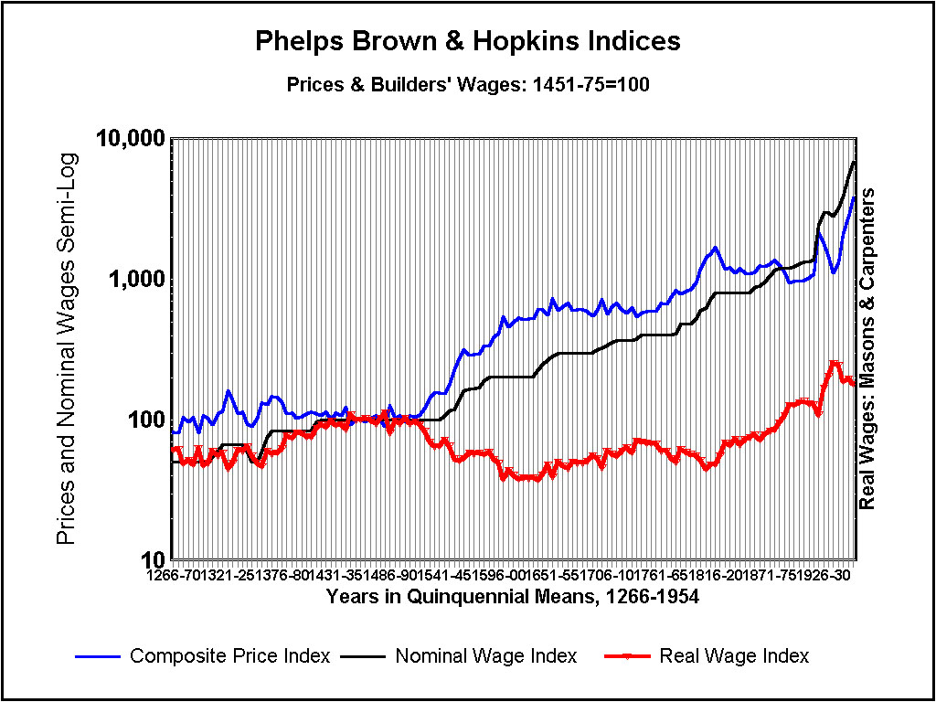

Slide 23
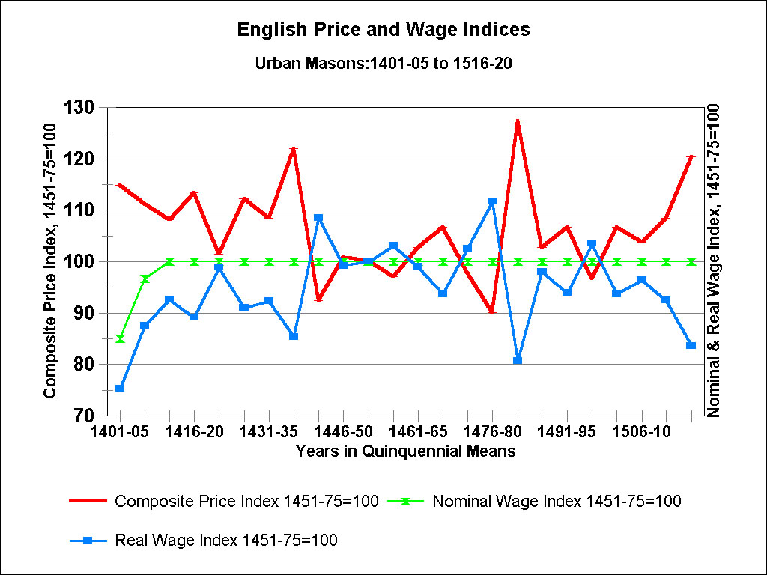

Slide 24
Differences between late-medieval England and the Low Countries
1) Warfare: England’s terrain: far less involved in Hundred Years’ War than was that of Low Countries,
also beset by civil wars, while England’s Wars of Roses (1455-87) had minimal impact.
2) Coinage debasements: as fiscal policies
a) rare in England: only in 1411 (purely defensive) and 1464-65 (more aggressive, under Edward IV): crown had ample revenues from wool-export taxes
b) very common in Low Countries, and always aggressive (war-related): in 1416, 1418, 1428-32, 1466-67, 1477, 1482-93
3) Urban excise taxes: absent in England (to 1652)

Slide 26
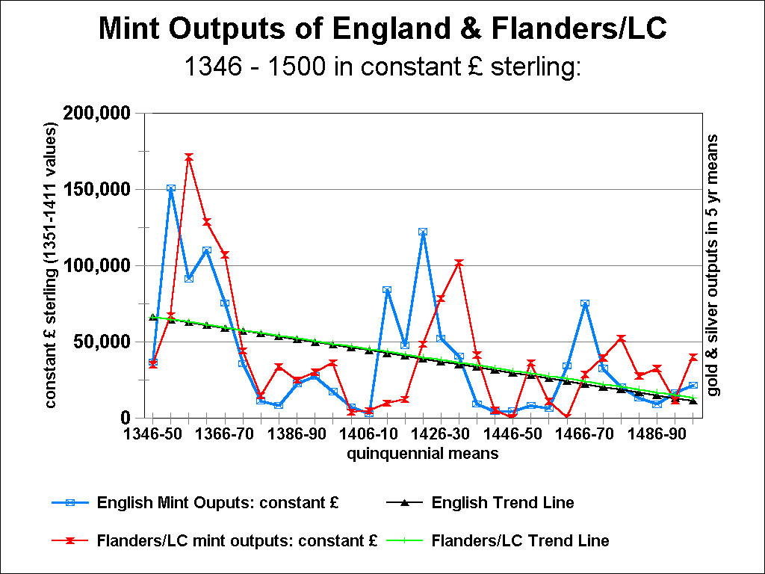

Slide 27
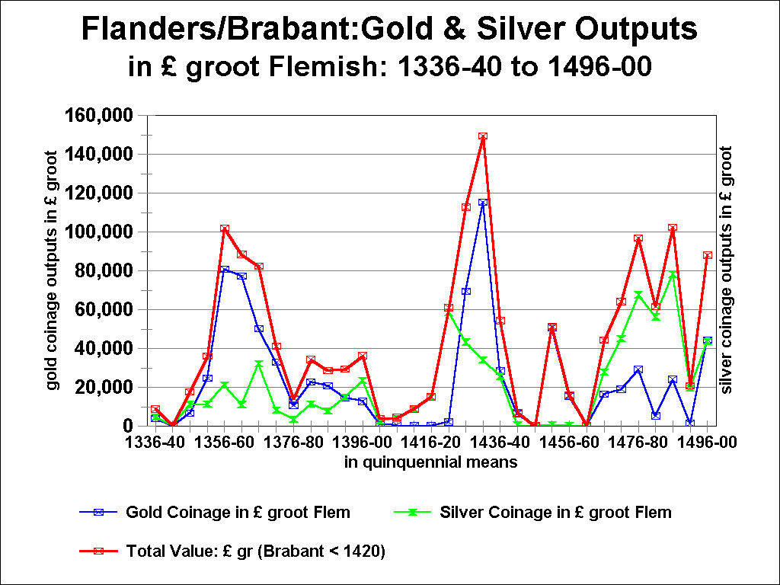

Slide 28
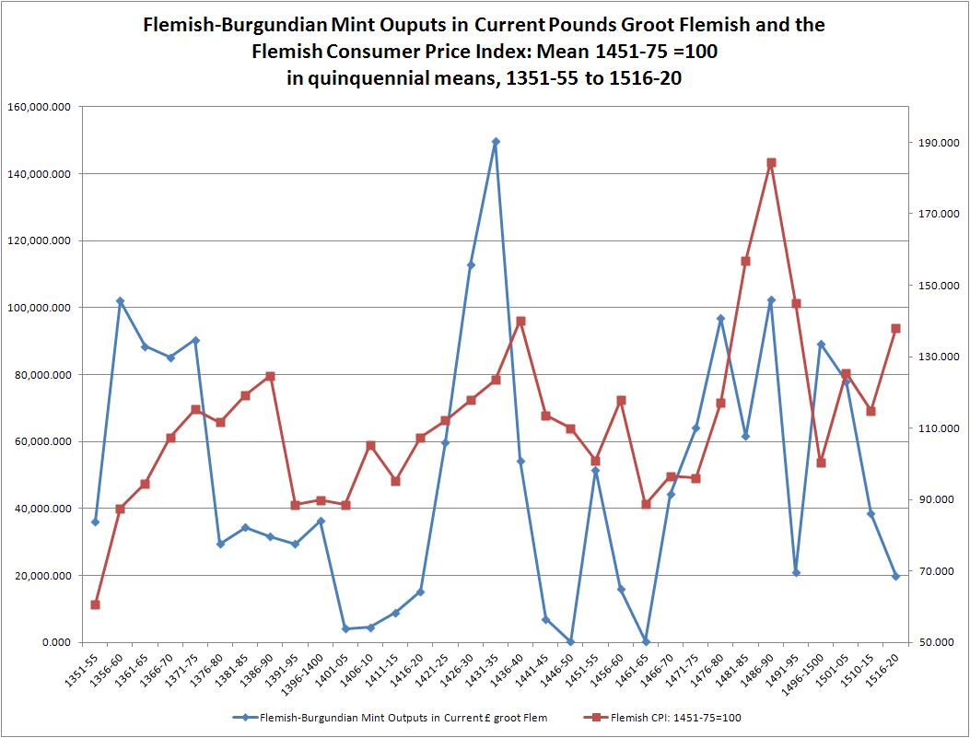

Slide 29
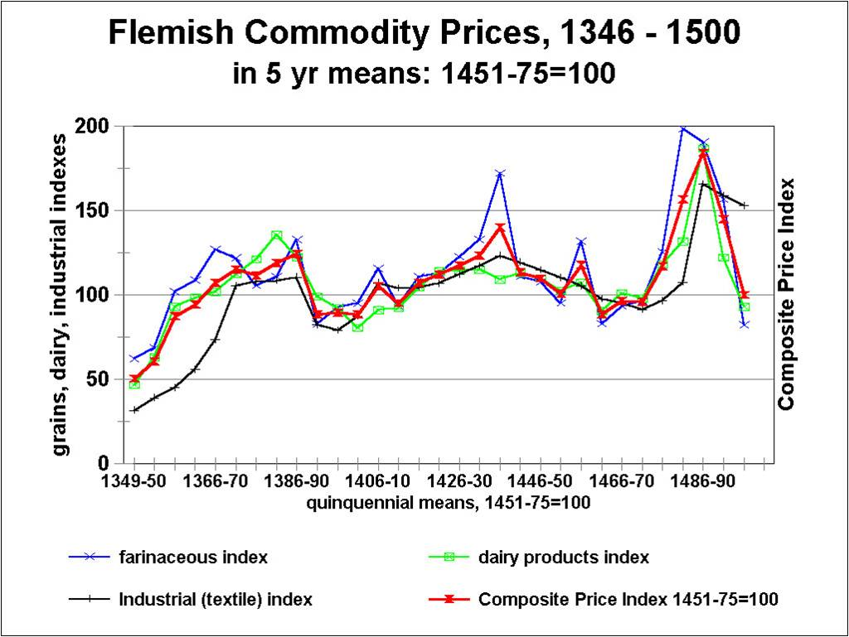

Slide 30
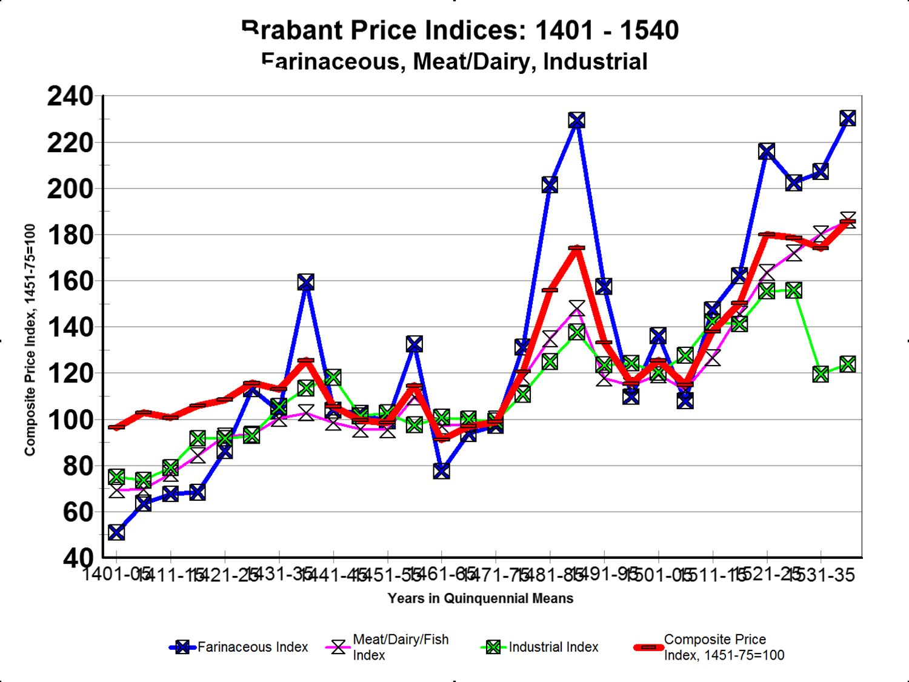

Slide 31
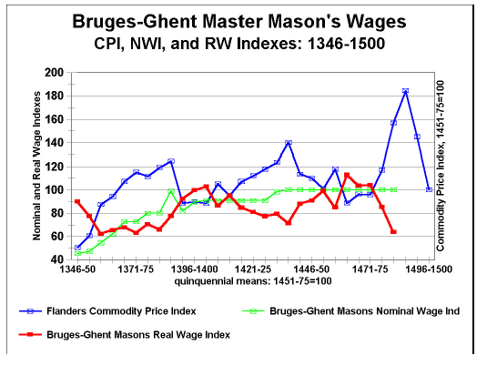

Slide 33
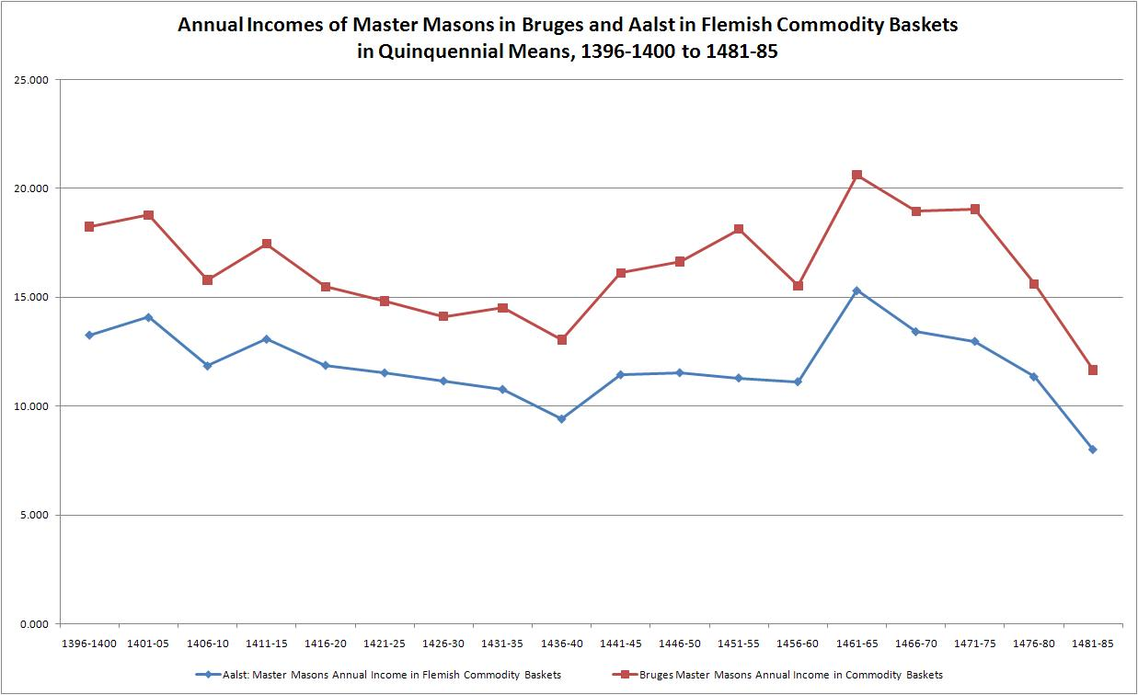

Slide 34
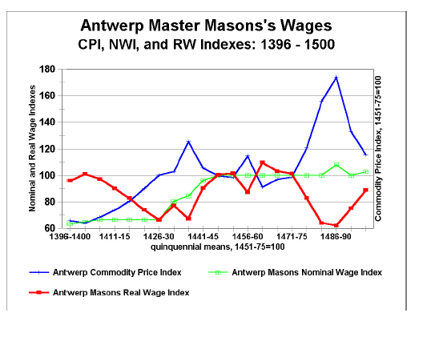

Slide 36
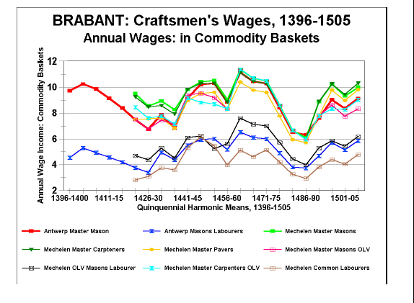

Slide 39
Urban Excise Taxes & Warfare 1
1) The evidence on REAL WAGES for the southern Low Countries in 15th century:
a) during periods of coinage debasements, real wages fell, and fell sharply
b) during periods of monetary stability, with monetary contraction and prevailing deflation, real wages rose, often sharply
2) But urban taxation often offset the real income effects of rising real wages - during the mid-century period of rising real wages

Slide 40
Urban Excise Taxes & Warfare 2
3) Urban taxes were also, to a large extent, war-related: to make required payments on public debts and the Flemish towns’ obligation to render subventions to the Duke: to finance Burgundian warfare and defence
4) Thus warfare was financed (everywhere) not through taxation but through borrowing
5) Public civic borrowing was in the form of sales of annuities: known as rentes or renten (not in form of interest-bearing loans)

Slide 41
Urban Excise Taxes & Warfare 3
6) Usury ban: explains why public borrowing was NOT generally in the form of interest bearing loans
a) From revival of anti-usury campaign in northern France, in 1220s, towns and principalities switched from loans to ‘rentes’ or annuities
b) rentes, based on an older agrarian contract, by which lenders & investors
- provided town & territorial gov’ts with a lump sum of money, never to be repaid
- in return for a life-time or perpetual stream of income

Slide 42
Urban Excise Taxes & Warfare 4
7) Papacy and Church Theologians on Rentes
a) 1250: Innocent IV decreed that rentes were not usurious PROVIDED that the buyer (lender-investor) could never require redemption of rentes, while sellers (debtor-issuers) were free to redeem them at will (but only at par)
b) rentiers: could instead reclaim some capital by selling rentes to 3rd parties ➔ growth of financial markets
c) 15th century Papal bulls (1425, 1452, 1455): upheld Innocent IV’s decree, while also stipulating that annual payments (de facto interest) for and redemptions of rentes had to come from the ‘fruits of the land’ [usufruct], as in any normal rent contract.
d) This form of public borrowing now almost universal

Slide 43
Urban Excise Taxes & Warfare 5
7) Papacy and Church Theologians on Rentes (cont’d)
e) excise taxes on the consumption of products of the land & sea met this provision: on wine, beer, bread, meat, fish, textiles (wool, linen), etc.
f) highly regressive form of taxation, hitting lower income strata far more than rich – and only urban inhabitants (not applicable in rural areas)
g) different from property taxes: which excluded poor
h) gov’ts: sold tax farms for right to levy these excise taxes (so that evidence is indirect)
8) Evidence from town of Aalst (eastern Flanders):

Slide 44
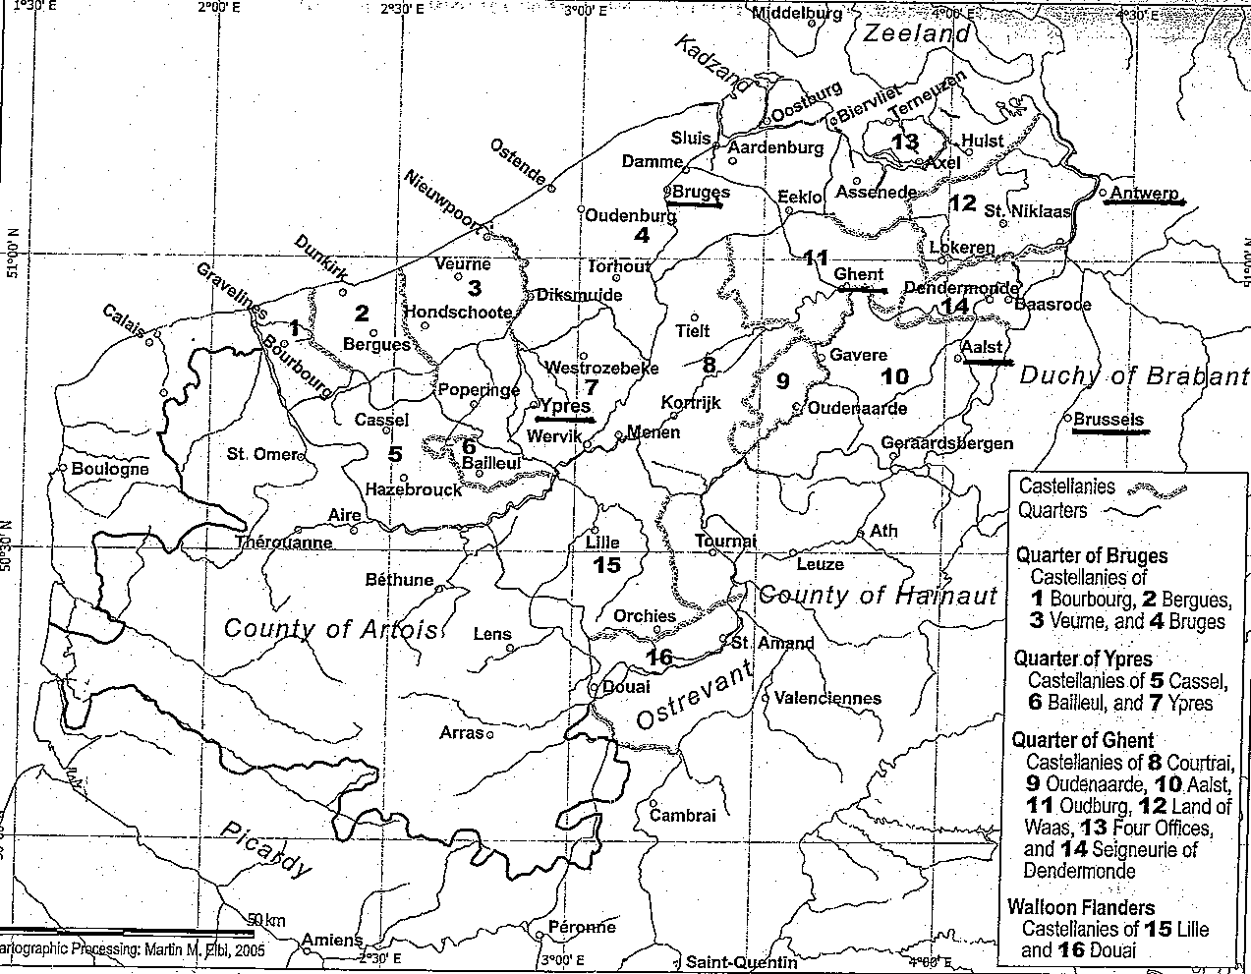

Slide 45
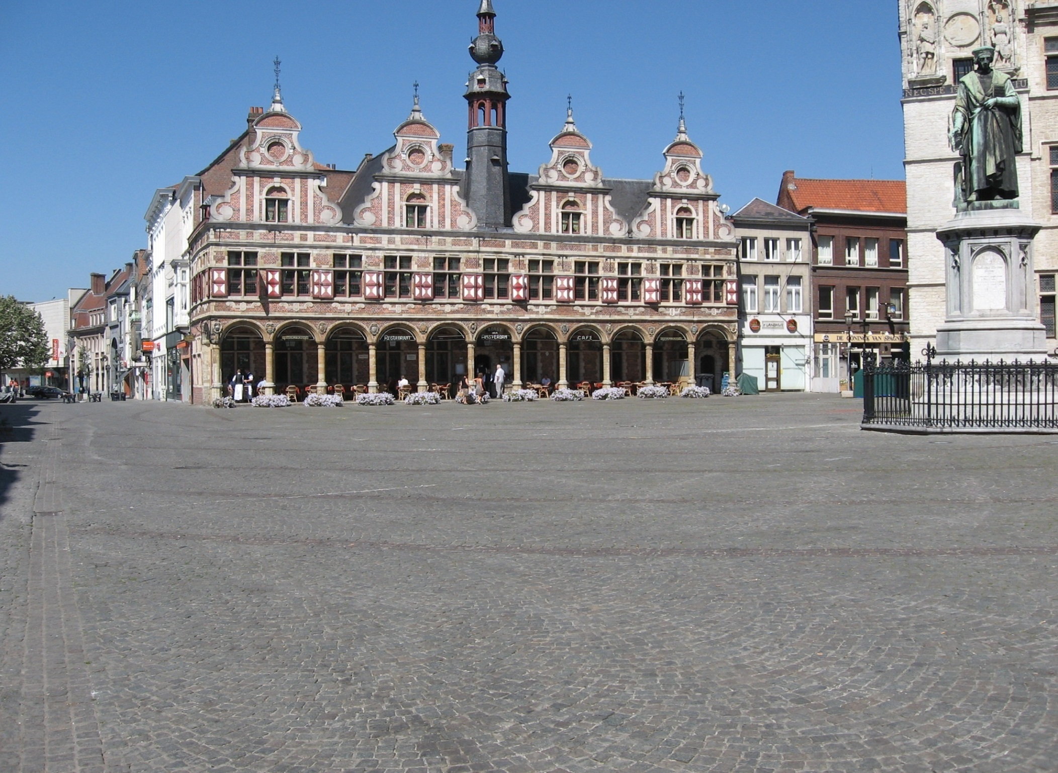

Slide 46
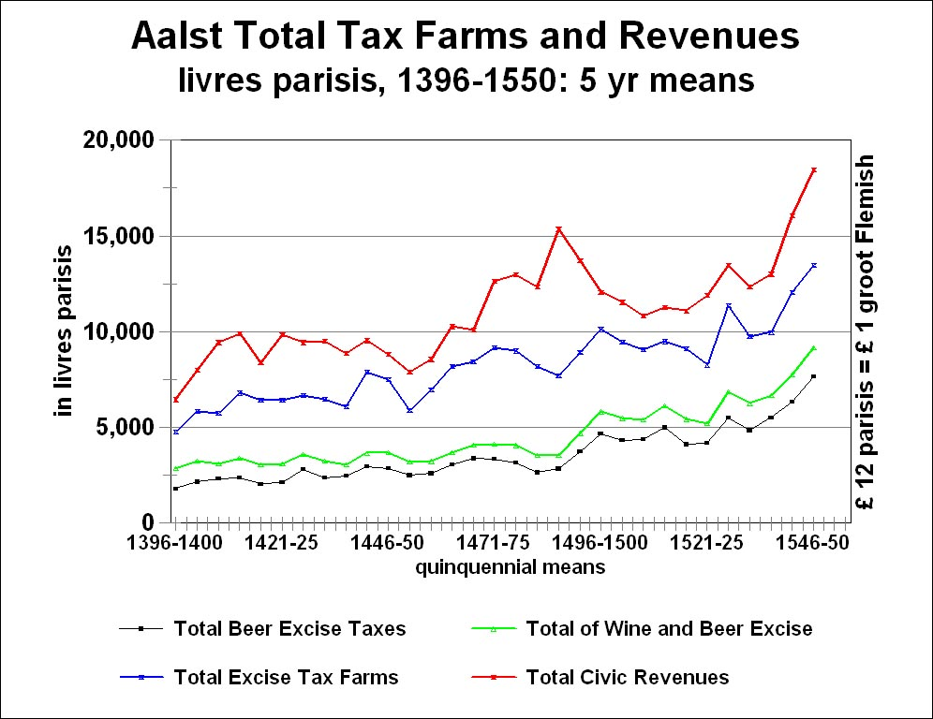

Slide 47
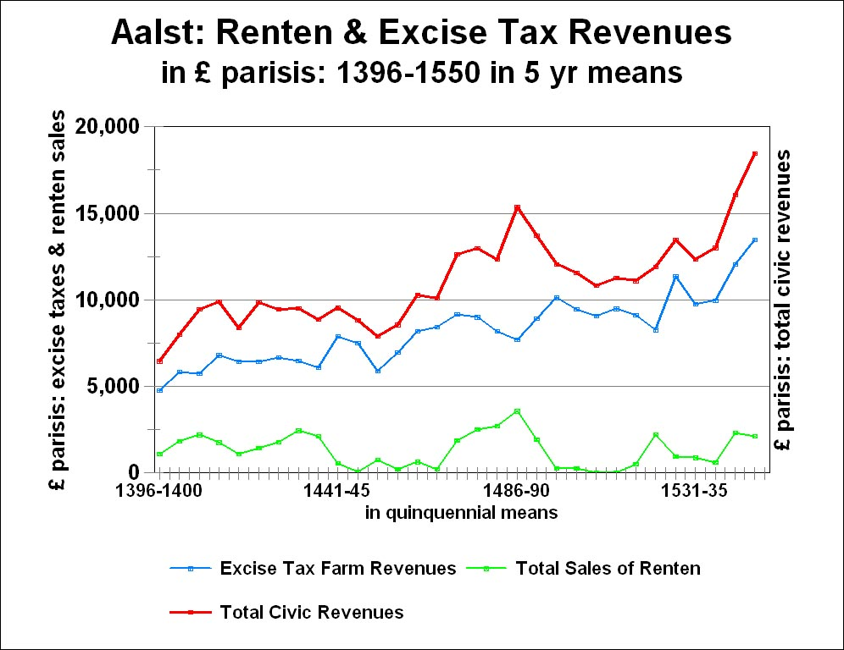

Slide 48
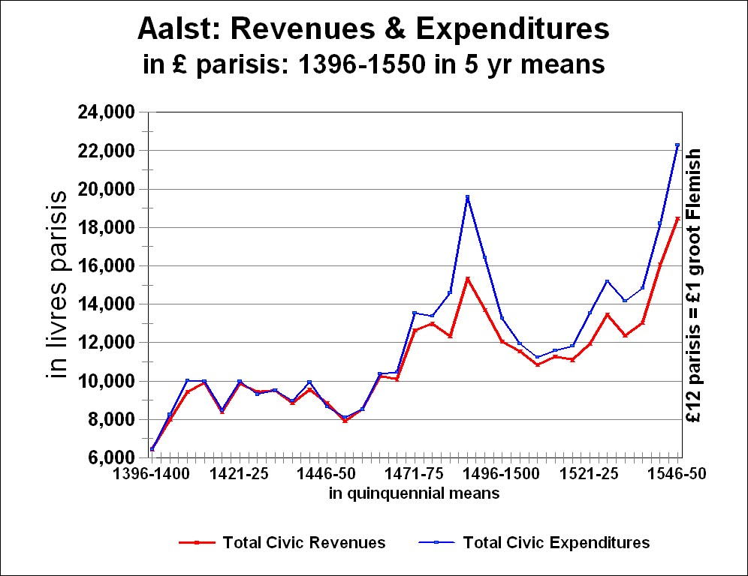

Slide 49
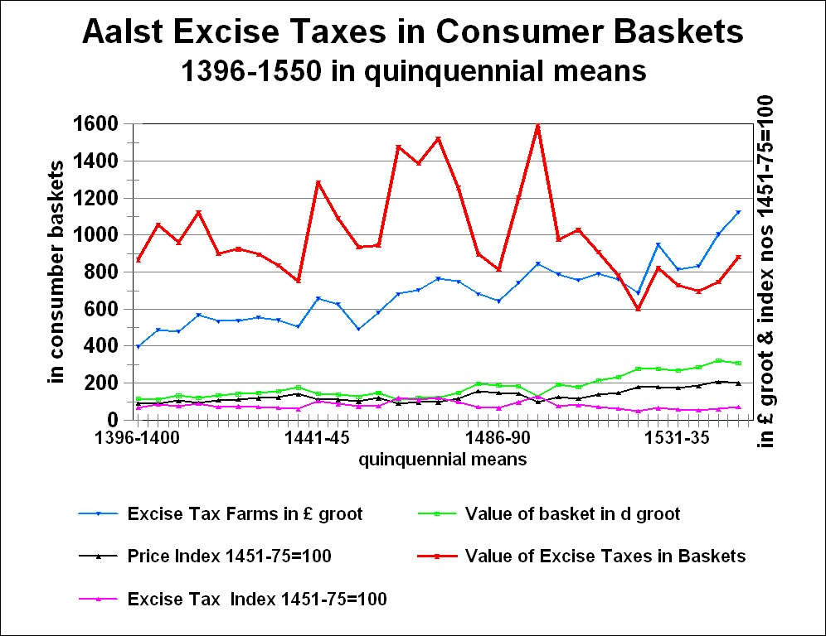

Slide 50
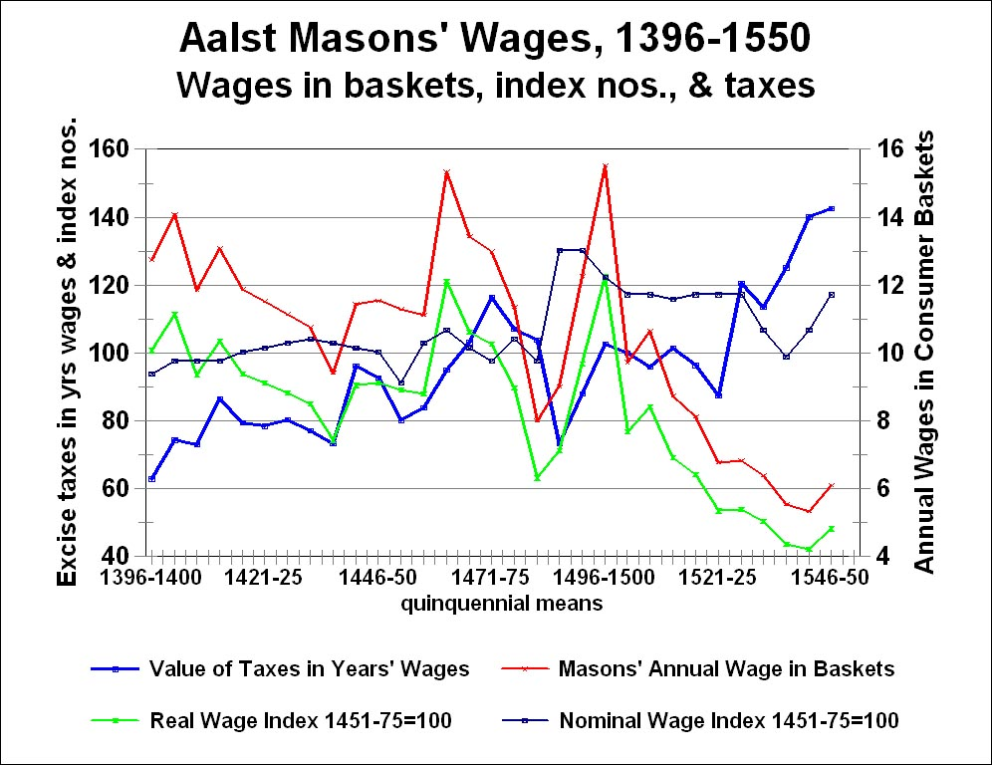

Slide 51
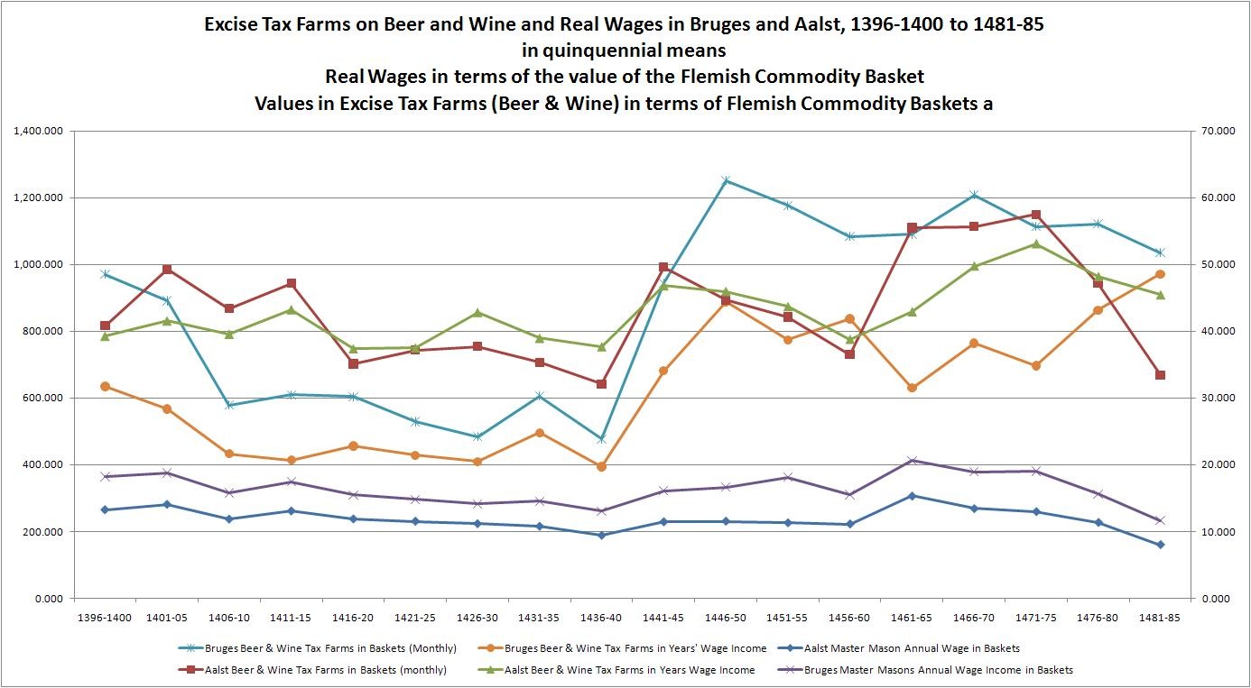

Slide 52
Urban Taxes and Population (1)
1) the Population Problem and Taxation
a) Flemish population continued to decline over course of 15th century – especially after the 1439 plagues
b) Problem: a smaller and smaller number of survivors were forced to bear the entire tax burden of financing previously incurred public debts: ➔ rising per capita taxes
c) Population: evidence varied (none for Aalst, ca. 4,000):
- Hulst: 3,600 in 1417 ➔ 3,000 in 1469: -17%
- Dendermonde: 9,000 in 1360 ➔ 4,500 in 1460: -50%
- Ypres: 10,523 in 1431 ➔ 7,626 in 1491: - 27.5%

Slide 53
Urban Taxes and Population (2)
2) Population and Poverty in duchy of Brabant
a) towns and villages of Brabant: lying to the east of Flemish town of Aalst
b) 1437 to 1496: no. of hearth fell by 19%: population fell even more, as household size contracted
b) Note the relationship between falling population and increasing poverty: i.e., proportion of ‘poor hearths’ that gained relief from property taxes (1437 ➔ 1480 only)
c) For excise taxes: never any such tax relief
d) hardly indications of a Golden Age

Slide 54
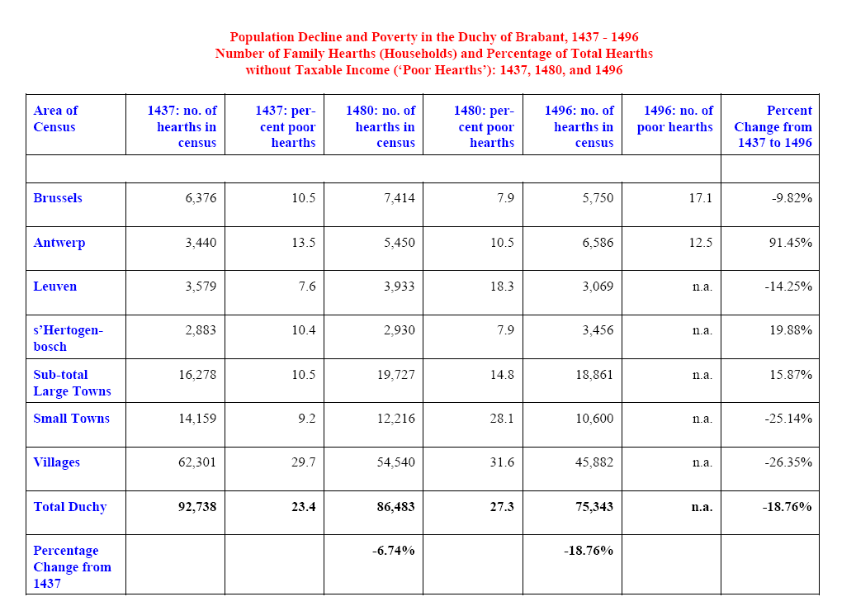

Slide 55
Industrial Decline: Textiles
1) Textiles, esp. high-grade woollens: industrial & commercial mainstay of Low Countries’ economies
2) England’s War-Related Fiscal Impositions on Wool-Export Trade: Calais Staple Bullion and Partition Ordinances, 1429 – 1473: to extort bullion & deny credit in Staple wool sales to Low Countries: added to existing burden of high English wool-export taxes (war-finance)
3) Major consequences: expansion of English cloth trade, ultimately vanquishing most of Low Countries’ draperies
4) Devastating injury of Calais Ordinances inflicted on LC luxury cloth industries dependent on English wools
5) Only partially offset by rise of those Flemish nouvelles draperies, which switched to Spanish wools

Slide 56
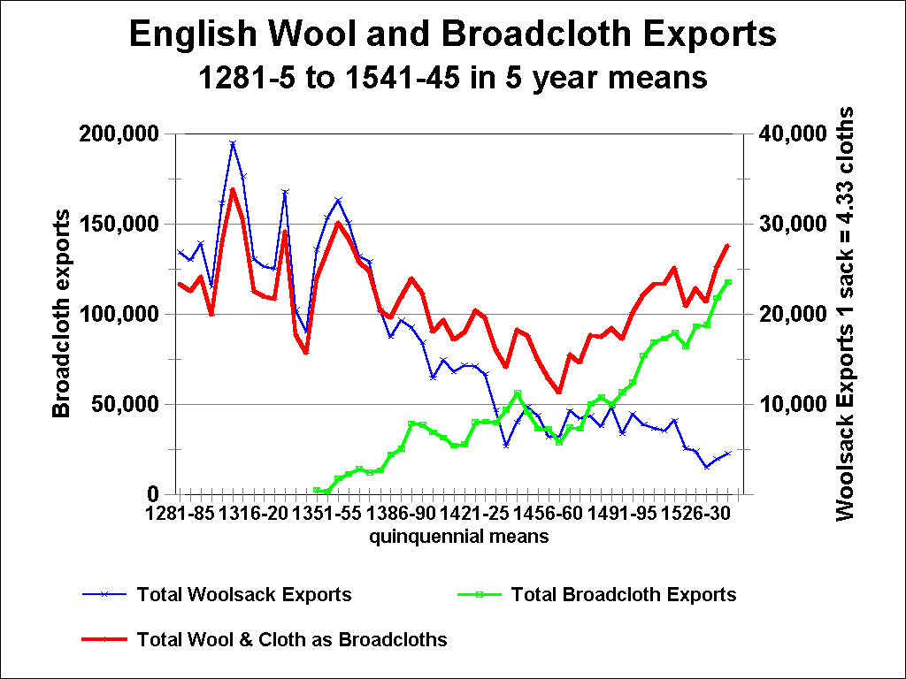

Slide 57
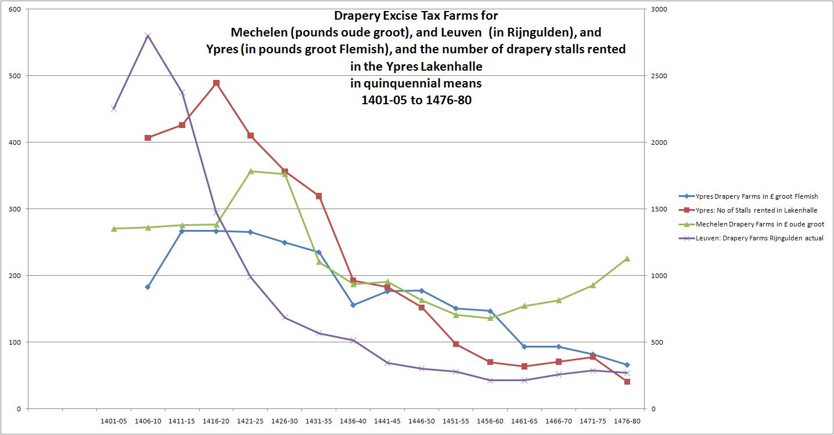

Slide 58
Conclusions for the southern Low Countries:
No Golden Age for their urban craftsmen, if we combine the accumulated evidence on:
(1) sharp declines in real wages during times of coinage debasements
(2) sharp increases in levels of urban excise taxes, which rose even during peace-time, with rising real wages
(3) population decline and increasing poverty (at least in Brabant, with number of ‘poor hearths’)
(4) Steep declines in urban woollen cloth outputs: in towns of both Flanders & Brabant

